Slide 1
Docker basic practice
EAE31-XC competence
01.Dec.2023

Slide 2
Agenda
Docker command basic
Docker basic practice
Docker Networking and Volumes practice
Docker compose practice
Advanced topic (optional)

Slide 3
https://docs.docker.com/get-docker/
Docker Installation Docker Desktop
Docker Installation Docker Engine for Linux
https://docs.docker.com/engine/install/ubuntu/

Slide 4
docker run: Create and start a new container from an image.
I. Docker command basic
docker run [options] image [command] [args]
Ex: docker run -d --name my-nginx -p 8080:80 nginx
-d: Run the container in the background.
--name my-nginx: Assign the name "my-nginx" to the container.
-p 8080:80: Map port 8080 on the host to port 80 on the container.
nginx: Use the official Nginx image.

Slide 5
docker ps: List running containers.
Docker command basic
docker ps
docker ps -a: List all containers (including stopped ones).
docker ps -a

Slide 6
docker stop: Stop a running container.
Docker command basic
docker stop container_id
docker start: Start a stopped container.
docker start container_id
docker restart: Stop and start a container.
docker restart container_id

Slide 7
docker exec: Run a command in a running container.
Docker command basic
docker exec [options] container_id command [args]
docker exec -it my-nginx /bin/bash
docker build: Build an image from a Dockerfile.
docker build [options] path_to_dockerfile
docker build -t my-node-app .
docker pull: Pull an image or a repository from a registry.
docker pull image[:tag]

Slide 8
docker push: Push an image or a repository to a registry.
Docker command basic
docker push image[:tag]
docker exec -it my-nginx /bin/bash
docker images: List local images.
docker images [options]
docker rmi: Remove one or more images.
docker rmi image_id

Slide 9
docker rm: Remove one or more containers.
Docker command basic
docker rm container_id
docker exec -it my-nginx /bin/bash
docker network ls: List networks.
docker network ls
docker volume ls: List volumes.
docker volume ls

Slide 10
docker-compose up: Create and start containers defined in the docker-compose.yml file.
Docker command basic
docker-compose up [options]
docker-compose down: Stop and remove containers defined in the docker-compose.yml file.
docker-compose down [options]

Slide 11
docker info: Display system-wide information.
Docker command basic
docker info
docker logs: Fetch the logs of a container.
docker logs container_id
docker inspect: Display detailed information on one or more containers, images, or networks.
docker inspect container_id

Slide 12
https://hub.docker.com/
Docker hub

Slide 13
1. Running Containers:
II. Practice Docker basics
Pulling images from Docker Hub.
Running containers with docker run.
Listing running containers.

Slide 14
2. Interacting with Containers:
II. Practice Docker basics
Executing commands inside containers.
Accessing container logs.
Copying files in and out of containers:
Copying into Containers:
docker cp <localfile> <container_id>:/<path/in/container>
Copying out of Containers:
docker cp <container_id>:/<path/in/container>/<filename> <local/path/on/host>

Slide 15
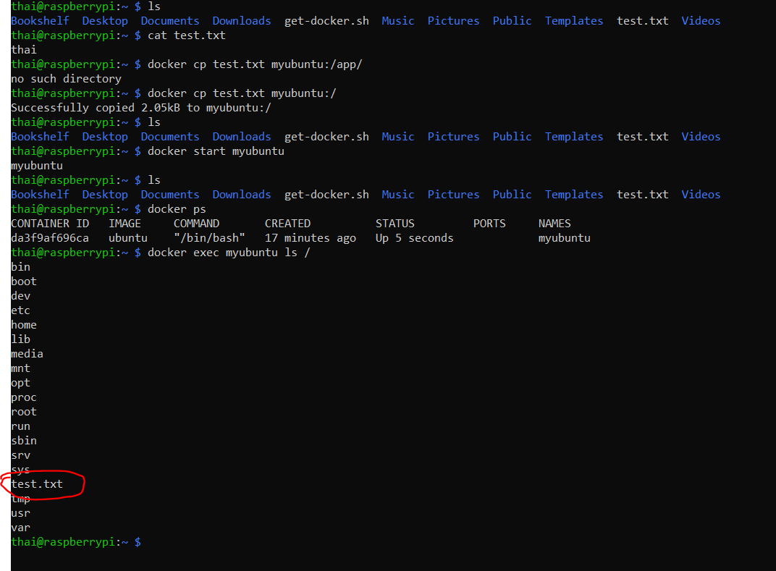
2. Interacting with Containers:
II. Practice Docker basics

Slide 16
3. Managing Images:
II. Practice Docker basics
Building images with Dockerfile.
Listing and removing images.
Pushing images to Docker Hub (if desired).

Slide 17
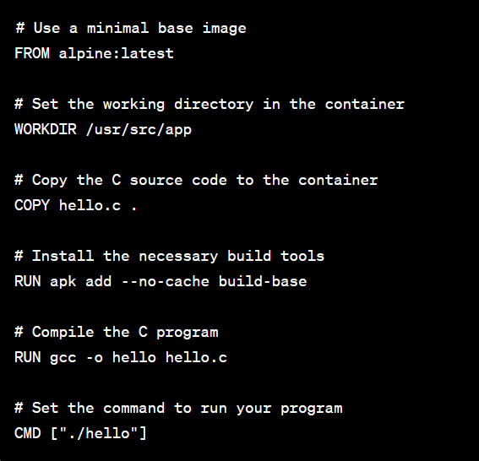
Create the docker file:
II. Practice Docker basics
Base Image: FROM alpine:latest - This uses the Alpine Linux distribution as a minimal base image.
Step 1: Create the Dockerfile:
Working Directory: WORKDIR /usr/src/app - Sets the working directory within the container.
Copy Source Code: COPY hello.c . - Copies the hello.c file from the local directory to the container.
Install Build Tools: RUN apk add --no-cache build-base - Installs the necessary build tools (compiler) using Alpine's package manager.
Compile the Program: RUN gcc -o hello hello.c - Compiles the C program into an executable named hello.
Working Directory: WORKDIR /usr/src/app - Sets the working directory within the container.

Slide 18
II. Practice Docker basics
Here are some common types of images:
Base Images:
These are the fundamental images upon which other images are built.
Examples include official images from Docker Hub like ubuntu, alpine, nginx, etc.
Scratch Image:
A special type of minimal image that has nothing in it. It is often used for building very lightweight and specialized images.
It's typically used in the context of multi-stage builds.
Custom Images:
Imges created by users for specific applications or services.
You can create custom images by writing a Dockerfile that specifies the base image, along with additional instructions to install software, configure settings, etc.

Slide 19
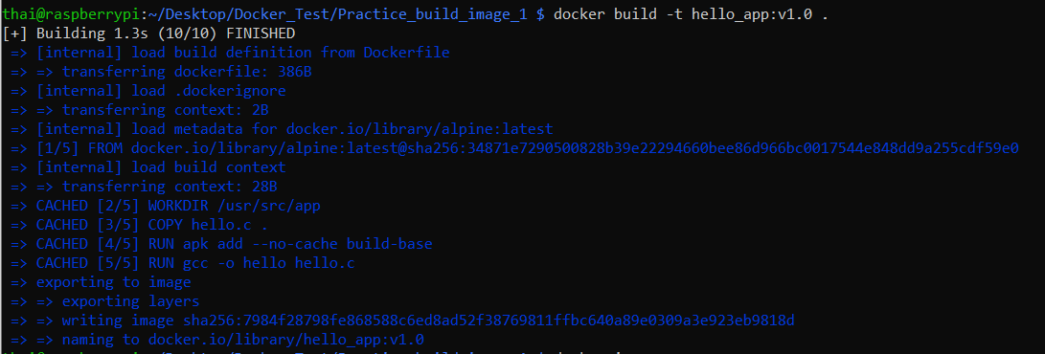
Create the docker file:
II. Practice Docker basics
-t: tag option
hello_app: name image
v1.0: tag name
Step 2: Build the docker image

Slide 20
Create the docker file:
II. Practice Docker basics
hello_app: name image
v1.0: tag name
Step 3: Run docker image

Slide 21
Some others useful command in docker file
II. Practice Docker basics
ADD: Similar to COPY, but with additional features like URL support and automatic extraction of compressed files.
Example: ADD http://example.com/file.tar.gz /tmp/
ENV: Sets environment variables in the image.
Example: ENV MY_VARIABLE=myvalue
ENTRYPOINT: Configures a container that will run as an executable.
Example: ENTRYPOINT ["python", "app.py"]
VOLUME: Creates a mount point for externally mounted volumes or other containers.
Example: VOLUME /data

Slide 22
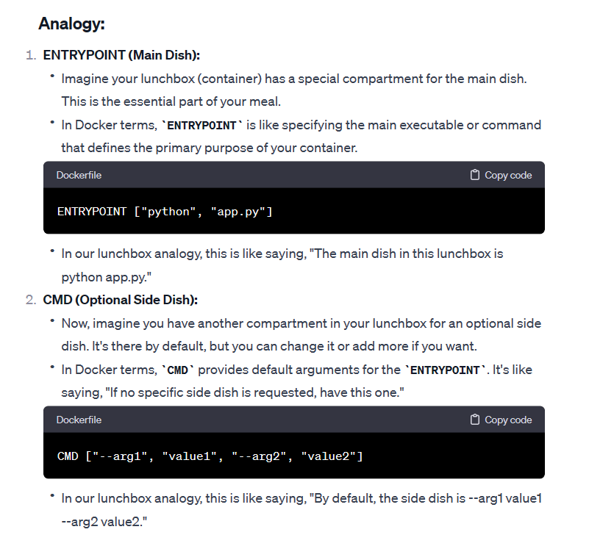
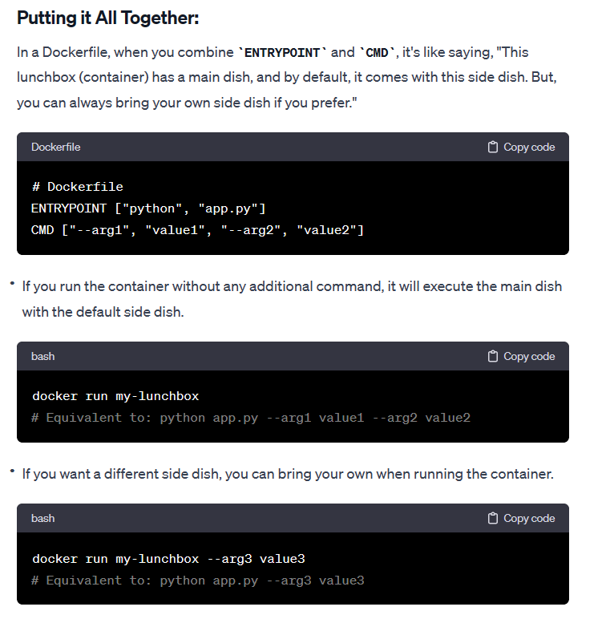
Different between CMD and ENTRYPOINT
II. Practice Docker basics

Slide 23
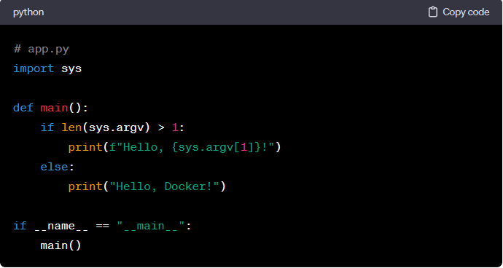
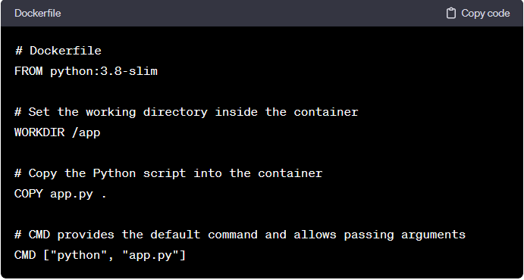
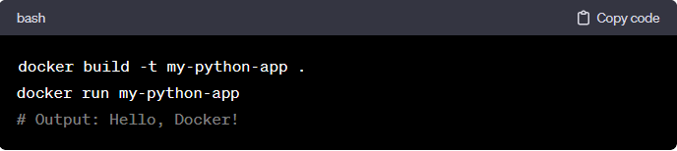
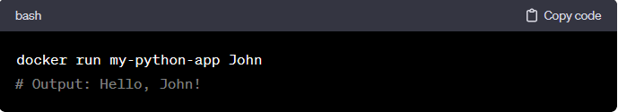
Different between CMD and ENTRYPOINT
II. Practice Docker basics
Default command
Command with custom argument

Slide 24
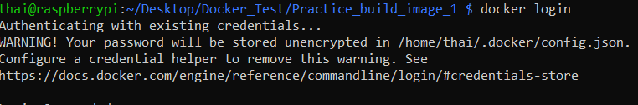
Push image to docker hub
II. Practice Docker basics
Step 1: Tag image
docker tag your-image-name:tag your-dockerhub-username/your-repository-name:tag
Step 2: Login to the docker hub

Slide 25
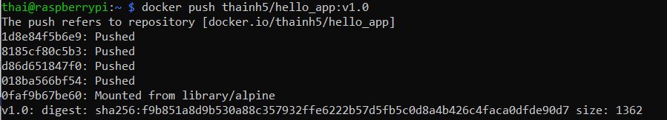
Push image to docker hub
II. Practice Docker basics
Step 3: Create repository in DockerHub
Step 4: Push the docker image to the DockerHub

Slide 26
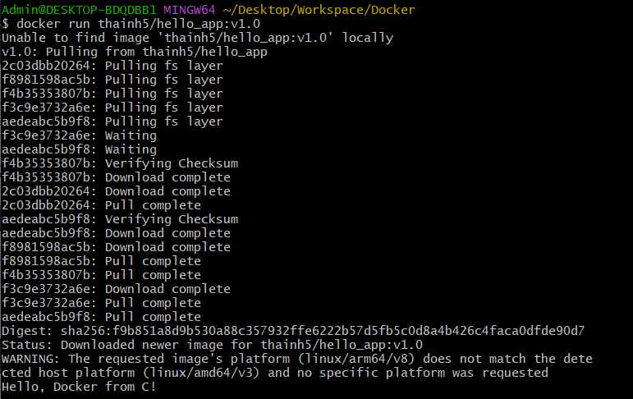
Build multi platform images
II. Practice Docker basics
Why?
Hello_app:1.0 was created default by arm64 host architecture
=> It cannot run in the amd64 host architecture

Slide 27
Buildx solution
II. Practice Docker basics
Step1: Install buildx
Step2: Create a builder instance
Step3: Build the multi platform image

Slide 28
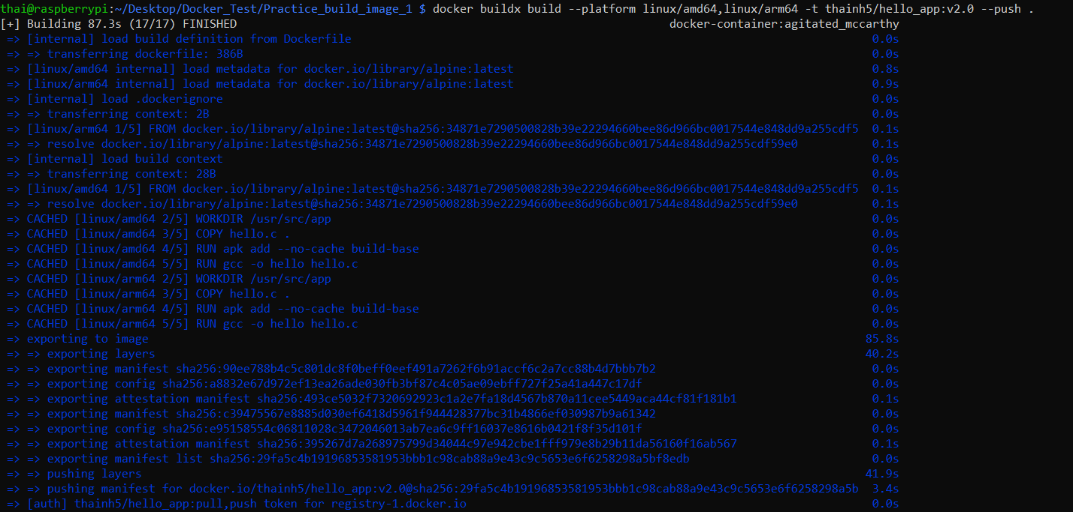
Buildx solution
II. Practice Docker basics
Step3: Build the multi platform image

Slide 29
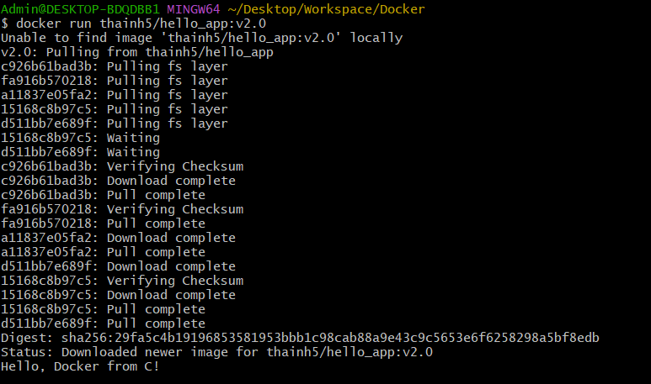
Buildx solution
II. Practice Docker basics
Step4: Try to run multi platform image on amd64 host architecture

Slide 30
III. Network and volume
1. Networking
Understanding container networking.
Exposing ports.
Linking containers.
2. Volumes
Introduction to Docker volumes.
Mounting volumes to persist data.
Managing data with volumes.

Slide 31
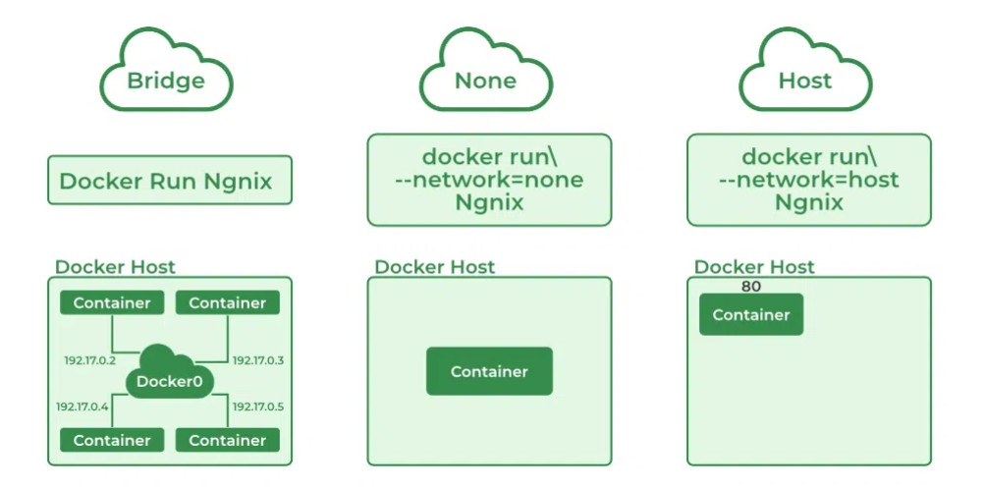
1. Networking 1.1 Understanding
III. Network and volume
Networking refers to the mechanisms that allow communication between different Docker containers, as well as between containers and the host system or external networks.

Slide 32
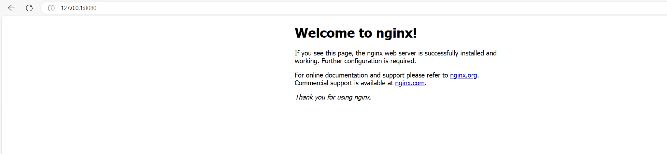
1. Networking 1.2 Expose
III. Network and volume
Allow communication between containers and the host system or external networks
docker run -d -p 8080:80 --name my-nginx nginx
Expose local network

Slide 33
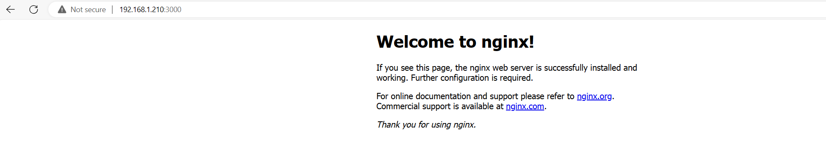
1. Networking 1.2 Expose
III. Network and volume
Allow communication between containers and the host system or external networks
Pi has IpAdress
Expose to external network:
Access from pc same network

Slide 34
1. Networking 1.3 Linking containers
III. Network and volume
Allow communication between different containers
https://www.youtube.com/watch?v=42H28M9rQq8

Slide 35
2. Volume
III. Network and volume
Bind Mounts:
A bind mount links a specific file or directory on the host to a path in the container.
It allows you to directly use files from the host in the container, and changes made in one location are reflected in the other.
Bind mounts are created using the -v or --volume option when running the docker run command.
Volume Mounts:
A bind mount links a specific file or directory on the host to a path in the container.
It allows you to directly use files from the host in the container, and changes made in one location are reflected in the other.
Bind mounts are created using the -v or --volume option when running the docker run command.

Slide 36
2. Volume mount and bind mount different
III. Network and volume
2.1 Lifecycle and Management:
Volume Mounts:
Docker manages volumes, and they persist even if no containers are using them.
Volumes are independent of the container lifecycle, and their data remains intact until explicitly deleted.
Volumes are the preferred method for persisting and sharing data between containers.
Bind Mounts:
Bind mounts depend on the host file system. If the host directory is deleted, the data is lost.
Bind mounts are directly linked to the host file system and don't have a separate management system like volumes.

Slide 37
2. Volume mounts and bind mounts different
III. Network and volume
2.2 Sharing data between containers:
Volume Mounts:
Volumes can be shared between multiple containers, allowing easy collaboration and data sharing.
Changes in one container are immediately visible in other containers using the same volume.
Bind Mounts:
Bind mounts are specific to a single container, and the data is not automatically shared with other containers.

Slide 38
2. Volume mounts and bind mounts different
III. Network and volume
2.3 Cross-platform compatibility
Volume Mounts:
More platform-independent, as Docker manages the volume creation and management.
Bind Mounts:
Can be sensitive to the host machine's file system details, potentially leading to issues when sharing between different operating systems.

Slide 39
2. Volume mounts and bind mounts different
III. Network and volume
2.4 Cross-platform compatibility
Volume Mounts:
Generally have better performance characteristics than bind mounts, particularly on Windows and macOS.
Bind Mounts:
May have slightly lower performance due to the direct link to the host file system.

Slide 40
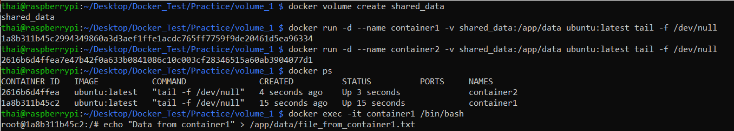
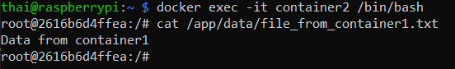
2. Volume mounts example
III. Network and volume
Run container1 in detached mode (-d), mounts the shared_data volume to the /app/data directory inside the container, and keeps the container running with the tail -f /dev/null command.
Create docker volume
Inside container1, create and modify something
Access container1 is running
Access container2 is running
The content of file_from_container1.txt should be visible in container2 as well.

Slide 41
2. Bind mounts example
III. Network and volume
This command runs a Docker container named mycontainer in detached mode (-d), with a bind mount. It maps the /home/thai/host_data directory on the host to the /app/containerdata directory inside the container
Inside the container, you can create or modify files in the /app/containerdata directory, and the changes will be reflected on the host in the /home/thai/host_data.

Slide 42
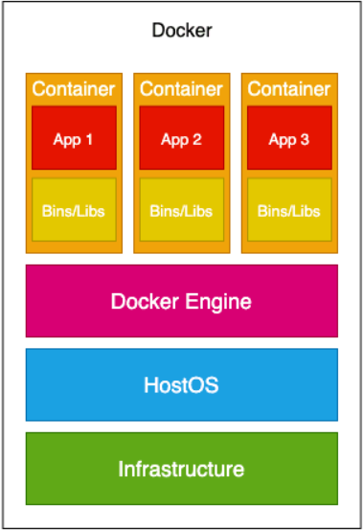
2. Bind mounts access to HW peripheral
III. Network and volume
- Docker containers are typically designed to be isolated from the host system.
- Limitations on accessing hardware peripherals directly.
- There are ways to grant Docker containers access to specific hardware on a
Raspberry Pi.
BUT: Accessing hardware from Docker containers might require running
the container in privileged mode, which could have security implications

Slide 43
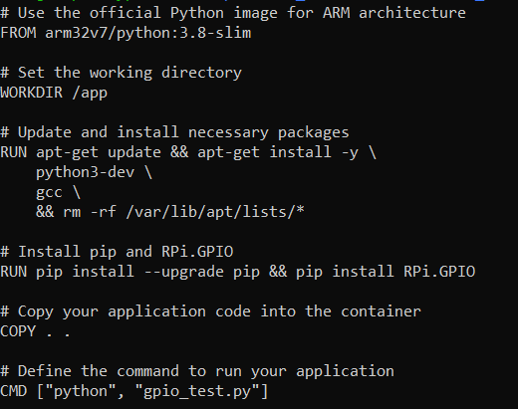
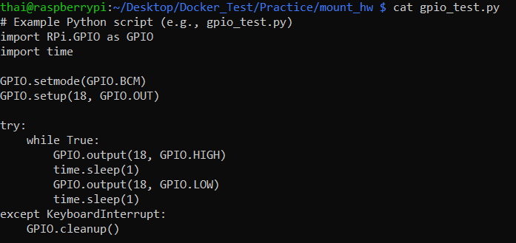
2. Bind mounts access to HW peripheral
III. Network and volume
Prepare Dockerfile
Prepare gpio_test.py

Slide 44
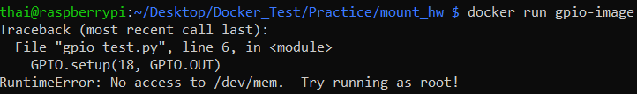
2. Bind mounts access to HW peripheral
III. Network and volume
Build to image:
Case1: Run image without privileged mode
Case2: Run with privileged mode and also, the -v /dev/gpiomem:/dev/gpiomem flag is used to mount the /dev/gpiomem device inside the container, allowing GPIO access.

Slide 45
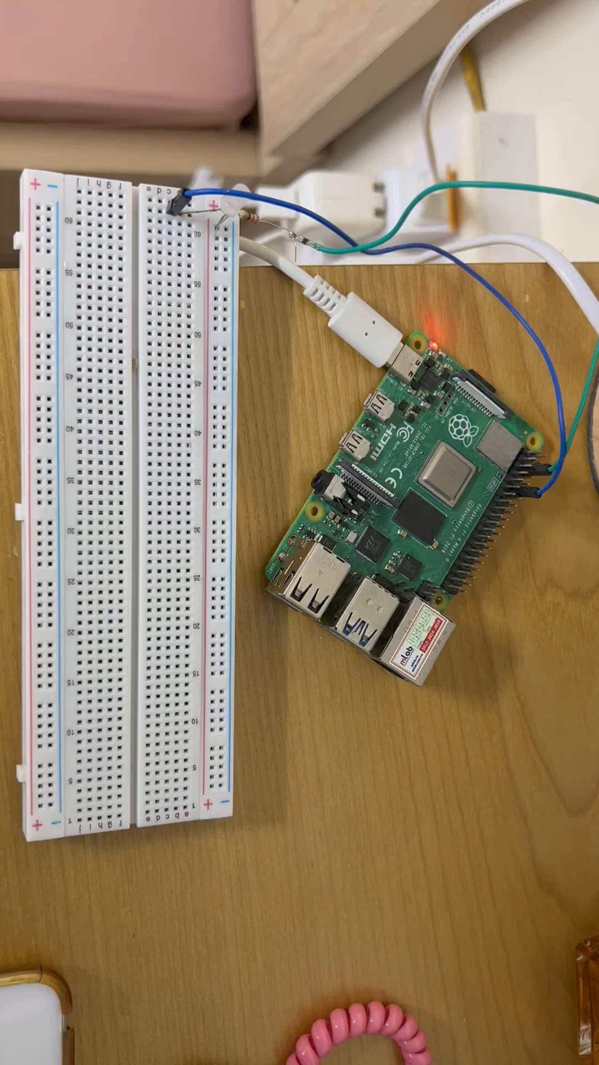
2. Bind mounts access to HW peripheral
III. Network and volume

Slide 46
IV. Docker compose
1. Introduction to Docker Compose:
Overview of Compose.
Writing a docker-compose.yml file.
2. Defining Multi-Container Applications:
Configuring services in Docker Compose.
Networking between services.
3. Running Multi-Container Applications:
Starting and stopping multi-container applications.
Scaling services.

Slide 47
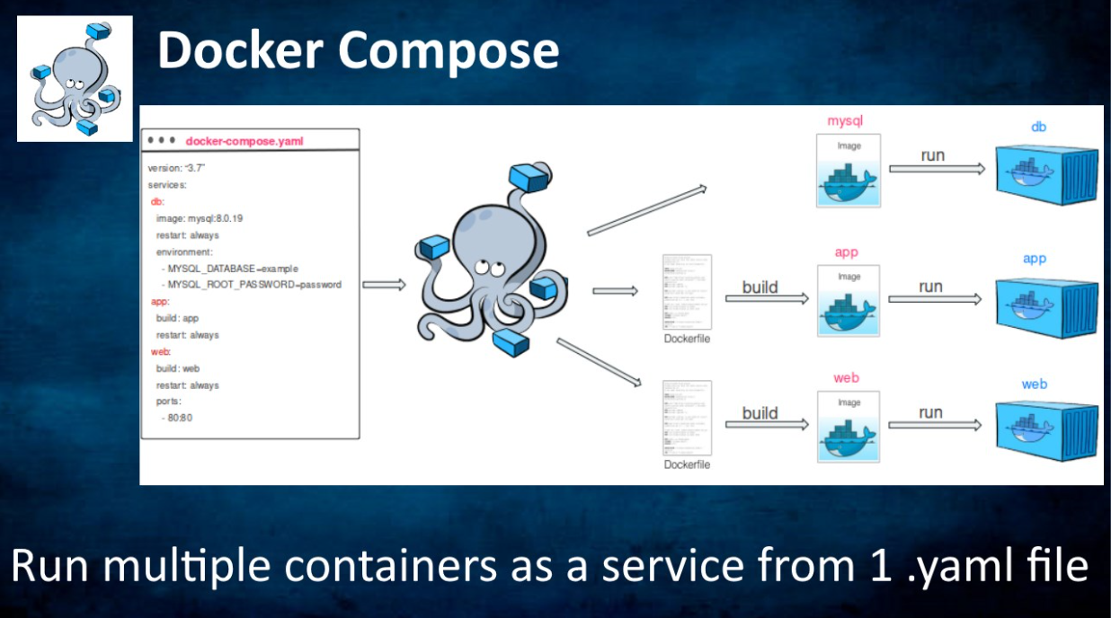
Overview
IV. Docker compose
- Docker Compose is a tool for defining and managing multi-container Docker applications.
- It allows you to define an entire application stack, including services, networks, and volumes, in a single file called docker-compose.yml.

Slide 48
Advantage points
IV. Docker compose
Simplified Configuration | - Docker Compose allows you to define your entire application stack, including services, networks, and volumes, in a single, easy-to-understand docker-compose.yml file. This simplifies configuration and reduces the complexity of managing individual containers.
Multi-Container Applications | - Many modern applications consist of multiple services or microservices that need to work together. Docker Compose provides a convenient way to define, configure, and run these interconnected containers as a single unit.
Local Development Environment | - Docker Compose facilitates the creation of consistent development environments across different machines. Developers can define the exact set of services, dependencies, and configurations required for the application, ensuring that everyone works in the same environment.
Dependency Management | - Docker Compose allows you to specify dependencies between services and control the startup order of containers. This is crucial in scenarios where one service relies on another, ensuring that dependencies are satisfied before a service starts.
Scalability | - Docker Compose makes it easy to scale services by specifying the desired number services.

Slide 49
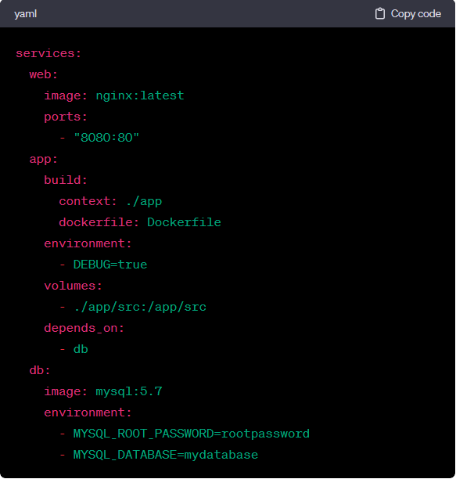
Docker-compose.yaml file
IV. Docker compose
Version: The version field at the top of the file specifies the version of the Docker Compose file syntax to use. It helps define the structure and features supported by the Compose file. Common versions include '2', '3', and so on.
Services: The services section is where you define the different containers (services) that make up your application. Each service has its own configuration settings.
Build: If your service needs to be built from a custom Dockerfile, you can use the build section to specify the build context and optionally the Dockerfile.
Image: The image field specifies the Docker image to use for a service. It can point to an image on Docker Hub or another registry.

Slide 50
Docker-compose.yaml file
IV. Docker compose
Environment: The environment section allows you to set environment variables for a service.
Volumes: The volumes section is used to mount local directories or named volumes into a container.
Ports: The ports section maps ports on the host to ports on the container.
Depends On: The depends_on section defines dependencies between services, ensuring that one service starts only after the services it depends on are running.
Networks: While not shown in the example, you can define custom networks to facilitate communication between containers.

Slide 51
Example 1: Docker Compose example that includes a web application using Node.js and a MongoDB database. In this example, we'll use Express.js for the web application and the official MongoDB image for the database.
IV. Docker compose
https://github.com/luckyfker/docker-compose-example1.git

Slide 52
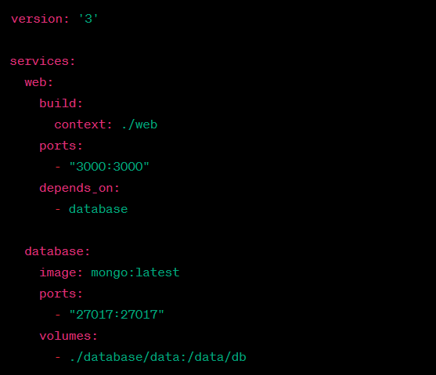
Docker-compose.yml
IV. Docker compose
Version: Specifies the version of the Docker Compose file syntax.
Services:
web: Defines the web service.
Build: Specifies that the service should be built using the Dockerfile located in the ./web directory.
Ports: Maps port 3000 on the host to port 3000 on the container.
Depends_on: Ensures that the web service starts only after the database service is up.
database: Defines the database service.
Image: Specifies the MongoDB image to use.
Ports: Maps port 27017 on the host to port 27017 on the container.
Volumes: Mounts the local ./database/data directory to the /data/db directory inside the container to persist MongoDB data.

Slide 53
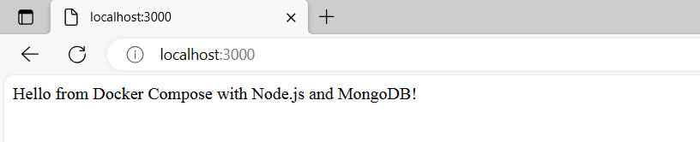
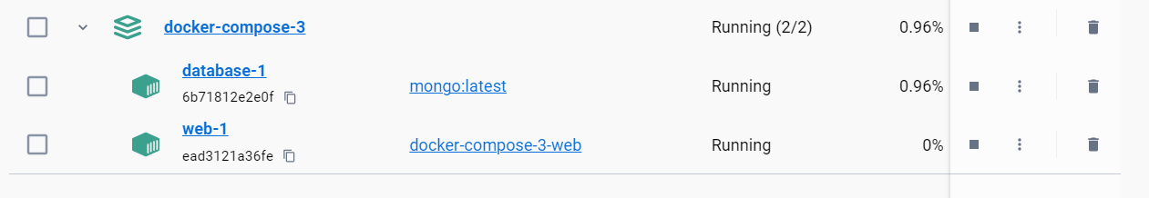
Docker-compose.yml
IV. Docker compose
$ docker-compose up
Container is running

Slide 54
Docker-compose.yml
IV. Docker compose
Version: Specifies the version of the Docker Compose file syntax.
Services:
web: Defines the web service.
Build: Specifies that the service should be built using the Dockerfile located in the ./web directory.
Ports: Maps port 3000 on the host to port 3000 on the container.
Depends_on: Ensures that the web service starts only after the database service is up.
database: Defines the database service.
Image: Specifies the MongoDB image to use.
Ports: Maps port 27017 on the host to port 27017 on the container.
Volumes: Mounts the local ./database/data directory to the /data/db directory inside the container to persist MongoDB data.

